Slide 1
Drugs in Gynaecology
Long Vo Chau Hoang

Slide 2
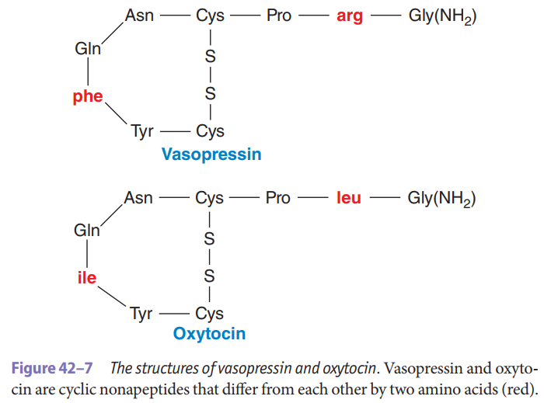
Oxytocin
a larger precursor in neurons whose cell bodies reside in the paraventricular nucleus and, to a lesser extent, the supraoptic nucleus in the hypothalamus.

Slide 3
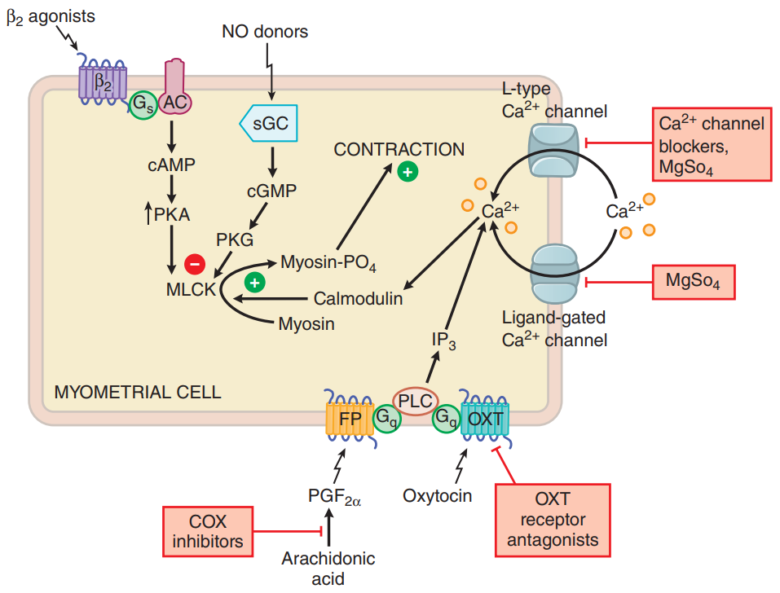
Oxytocin
Receptors: OXTR couples to G_{q}/G₁₁, activating the PLC_{β}-IP3-Ca²⁺ pathway.
Secretion:
Inhibited by estradiol and relaxin from ovarian, ethanol.
Stimulated by pain, hemorrhage, dehydration.

Slide 4
Oxytocin

Slide 5
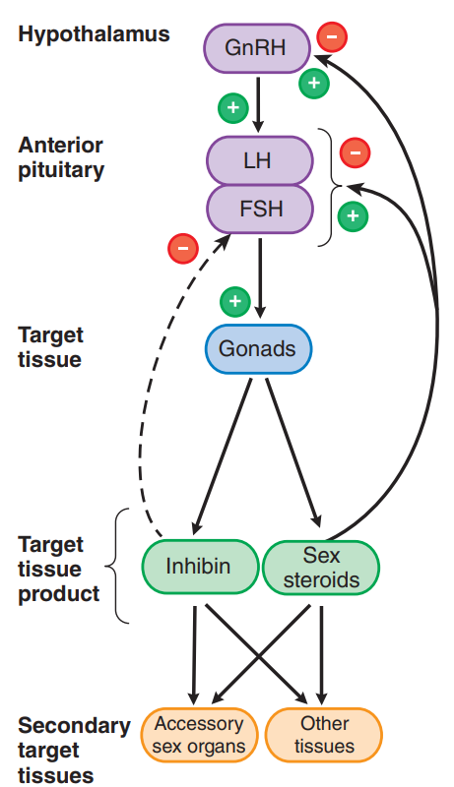
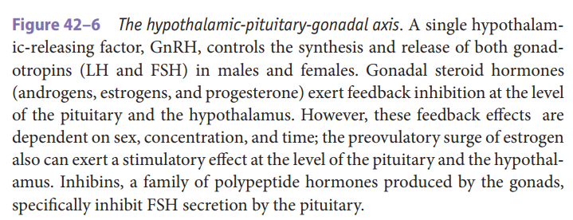
Gonadotrophin

